Slide 1
Regression

Slide 2
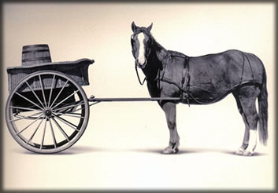
Let’s Practice
Open A_Regression.R
Predict Diamond Prices with linear regression.

Slide 3
The Problem of Overfitting
Statistical models can produce highly complex explanations of relationships between variables
The “fit” may be excellent
When used with new data, models of great complexity may do not do so well.
Notes:
3

Slide 4
100% fit – not useful for new data
Notes:
4

Slide 5
Another view of overfitting to a problem…

Slide 6
Minimize Overfitting - Partitioning
Divide data into training portion and validation portion
Test model on the test portion
Training Data
All Data
Test Data
Notes:
How do you want to “spend” data

Slide 7
Minimize Overfitting - Partitioning
Divide data into training portion , validation & test portions
Tune a model and/or compare models with the validation portion
The “true” way a model will behave when launched on new data.
Training Data
All Data
Validation
Data
Test Data
Notes:
How do you want to “spend” data

Slide 8
Best Practice
If you have enough data and the model impact is large, this is a good partitioning schema
However, this much effort is not always undertaken.
Feature Engineering
Data
Training Data
All Data
Validation Data
Test Data
Notes:
How do you want to “spend” data
For large data – production, 10% improvement = $500M; 10% overfitting = $-500m
Additional layer of partitionoing CV discussed later

Slide 9

Next Glass
Next Glass is now out of business but leveraged chemistry & modeling for it’s business model.

Slide 10
Let’s Practice
Open B_anotherGlass.R
Engineering/Train/
Validation/Test
Train/Test
Train/Validation/Test

Slide 11


Supervised Learning
Inferring a function from labeled data.
“Learn from telling”, “Look at my data and I will tell you what to predict”
Data Setup
Algorithm
Business Context
Application
Marketing-Will a customer buy yes or no? How much will a customer spend?
Operations- Will an applicant default? When will a machine break?
Sports Analytics- How many points will the Bears’ QB score? What is the Bears’ probability of winning?
Requires expertise and stakeholder buy in
Flat “Excel” file. Each row is a record or observation. Each column is an attribute of the record.
One column is the outcome, y or target attribute.
Modeling e.g. K-NN, linear regression, decision tree, random forest etc.
Use the model to make predictions for the target label on the new data.

Slide 12

Supervised Learning Example
Inferring a function from labeled data.
“Learn from telling”, “Look at my data and I will tell you what to predict”
What impacts ice cream sales?
#
=ƒ(…)
Notes:
Just did carat to diamond prices
Now let’s add more than 1 input

Slide 13
Linear Regression for continuous outcomes
#
= $β$ + ($β$*temperature) + ($β$*day) + ($β$*price) + error
Some linear combination of temperature values, day of the week dummy variables and price estimate the number of cones that will sell.
Notes:
What should we expect the beta signs to be? Whats the relationship the information has with ice cream sales?
Temp goes up? Sales go up. Temp goes down? Sales go down. Positive relationship
Price goes up? Sales go down. Price goes down? Sales go up. Negative relationship

Slide 14
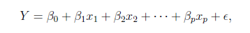
The linear combination equation captures information
outcome
coefficients
constant
error (noise)
predictors

Slide 15
The linear combination equation captures information
Outcome:
The “dependent”, “y” or “target”.
Number of Ice Cream Cones

Slide 16
The linear combination equation captures information
Constant:
The “intercept” or “beta-naught” has no predictor associated with it.
Avg. Number of Ice Cream Cones expected to sell if predictors were all 0.

Slide 17
The linear combination equation captures information
Predictors:
The “informative features”, “x” or “independent” variables.
Variables affecting sales in the data, temp, day, & price.

Slide 18
The linear combination equation captures information
Coefficients:
The “weight”, “betas” or “coefficients” multiplied with the specific “x” variable value.

Slide 19
The linear combination equation captures information
Error:
The “error” or “noise” represents the value the equation is wrong compared to the actual Y.

Slide 20
The linear combination equation captures information
outcome
coefficients
constant
error (noise)
predictors
The combinations of beta coefficients seeks to minimize the squared errors between the actual Y values and the equation. This combination manifests as the “best fit line”

Slide 21
#
= $6$ + 0.$25$*temperature + $3$*satudray_dummy + -0.5*price
Beta-Naught | Temperature | Saturday_dummy | Price
6 | 0.25 * 80 degrees | 3 * 1 | -0.5 * 5
6 | 0.25 * 88 | 3 * 0 | -0.5 * 2

Slide 22
#
= $6$ + 0.$25$*temperature + $3$*satudray_dummy + -0.5*price
Beta-Naught | Temperature | Satuday_dummy | Price | Best Fit Prediction
6 | 0.25 * 80 degrees | 3 * 1 | -0.5 * 5 | 26.5
6 | 0.25 * 88 | 3 * 0 | -0.5 * 2 | 27

Slide 23
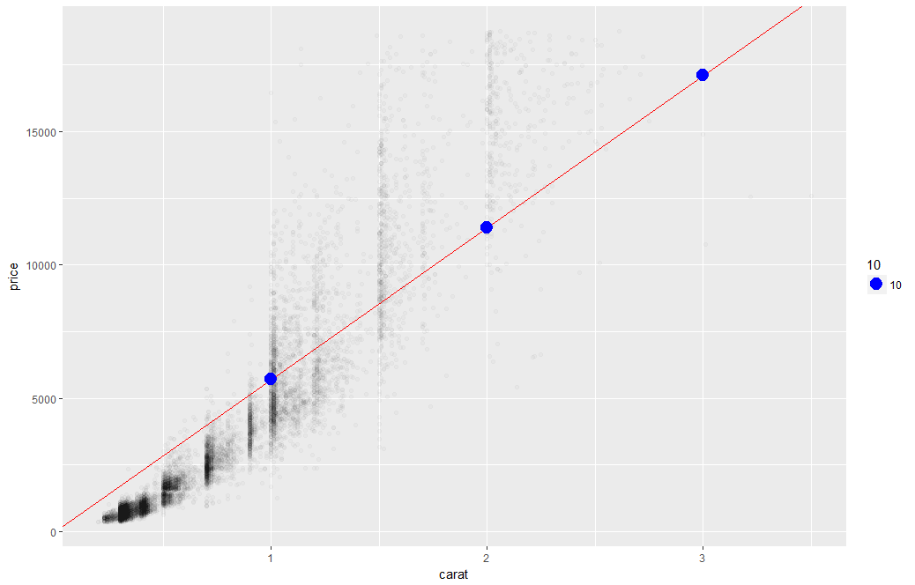
What’s really going on?
Errors between a prediction and actual.
Notice some are negative and some are positive

Slide 24
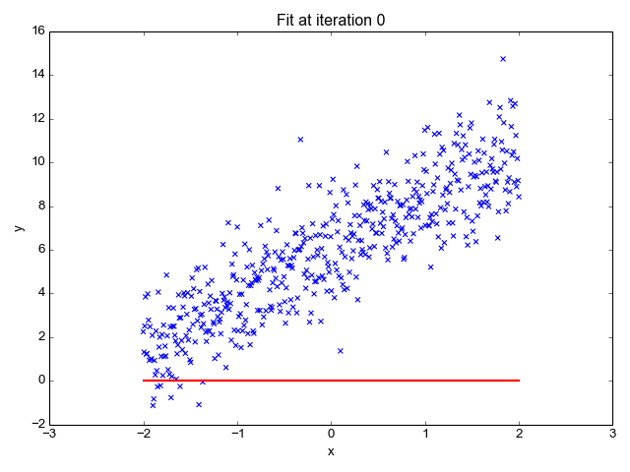
So what is really going on?
The algorithm is optimizing the inputs and weights (beta’s) to minimize the sum of squared errors.
This is called “ordinary least squares (OLS).

Slide 25
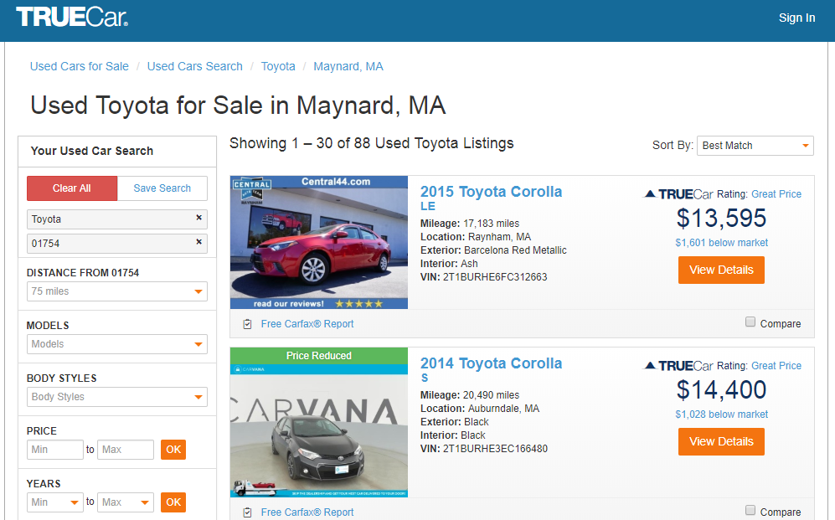
How does truecar.com know the price is “great?”

Slide 26

Yeah! I got a new job!

Slide 27

Welcome Dale to TrueCar’s Competitor: OldCar
Dale, can you predict used car prices? Then we will know if a car is priced above/below expected value

Slide 28

Let’s help Dale again.
But of course. This sounds like a predictive modeling project.

Slide 29
Modeling Process
SEMMA (from SAS)
In this course…
1. Sample
In this course, most data sets are curated for you, but partitioning is done to avoid overfitting.
2. Explore
As part of your analysis you perform basic exploratory data analysis (EDA)
3. Modify
Data Processing: cleanup, dimension reduction, feature engineering & feature enrichment
We will just use library(vtreat) for variable treatment
4. Model
You will learn regression, logistic regression, decision tree and random forest (time permitting). You are expected to try all that are appropriate.
5. Assess
Many KPI, but in this intro class we will use Accuracy for classification and RMSE, MAPE for regression

Slide 30
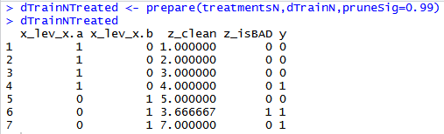
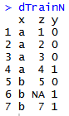
Variable Treatment: library(vtreat)
Vtreat automates some data cleaning, imputation and engineers specific response encoded variables.
Step 3
treatmentsN <- designTreatmentsN(...)
“Prepare” Data into a treated Modeling Matrix
Step 2
“Design Treatment” - Categorical or Numeric outcome
Step 1
Organize Informative Data

Slide 31
Vtreat adjusts data in many ways.
Action | Type | Description
Imputation | Cleaning | Na, Nan, Inf replacement with mean
Imputation Indicator | Cleaning | Append a binary column as imputation flag
Dummy Variables | Cleaning | Create dummy variables for categorical variables
Constant Attribute Suppression | Cleaning | Remove variables with a single value.
Level Deviation –”cat_D” | Engineering | A “deviation fact” about a categorical level. Tells us if ‘y’ is concentrated or diffuse when conditioned on the observed level of the original categorical variable.
Level Prevalence- “cat_P” | Engineering | A “prevalence fact” about a categorical level. Tells us if the original level was rare or common.
Estimated Single Variable Effects – “cat_B” = categorical outcome w/Bayesian “cat_N” = numeric outcome w/Regression | Engineering | A single variable Bayesian model of the change in logit-odds in outcome from mean distribution conditioned on the observed value of the original variable. A single variable regression model of the difference in outcome expectation conditioned on the observed value of the original variable.
Rare Cats* | Engineering | For categorical levels below a frequency threshold, pool different levels into a common “rare-level” variable
Notes:
Does NOT check for co-linear variables
Does not perform outlier suppression

Slide 32
Let’s practice.
Open C_newCar.R
Using the preprocessing and partitioning code in your toolbox, create a linear model of Toyota prices.

Slide 33

Regression is susceptible to multi-colinearity
Math
The presence of two or more predictor variables sharing the same linear relationship with the outcome variable.
Don’t shock the cat by having multi-collinearity.
In other words
Two+ informative features are measuring essentially the same thing.
Example
When predicting ice cream sales you include Fahrenheit and Celsius temperatures as two separate informative features.

Slide 34
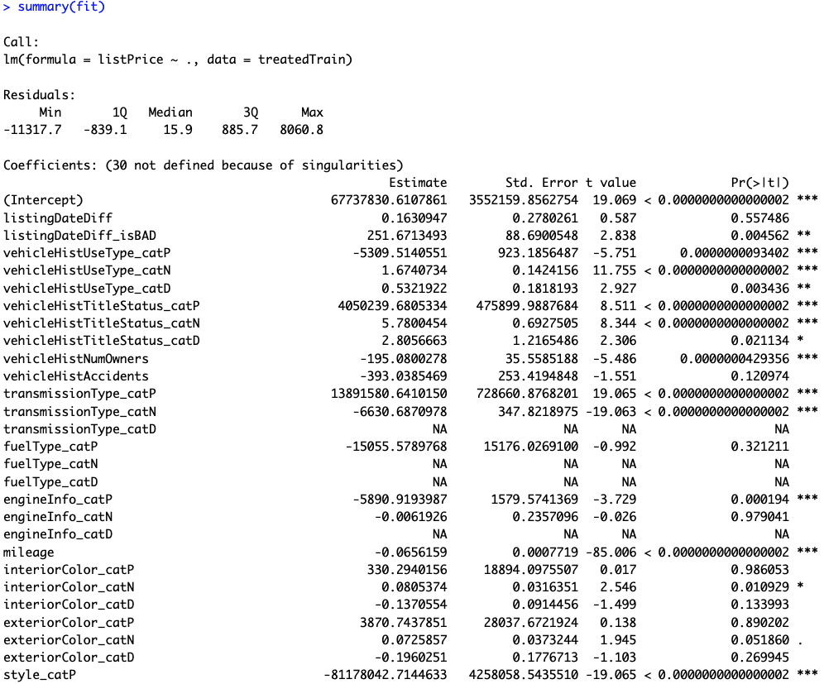
The Summary of the Fit
Auto ID of multi colinearity

Slide 35
The Summary of the Fit
P-Values
The probability of seeing a value larger than the t value.
Small p-values mean its less likely due to chance.

Slide 36
The Summary of the Fit
P-Values
In stats p <0.05 is good but in business I have seen p<0.2.
It’s a good idea to rebuild a model without variables that do not meet the cutoff.

Slide 37
Back to the script C

Slide 38
Parsimonious Model
Parsimony or compactness is desirable in models. The more features in a model, the more complexity we introduce, data integrity, data interactions, time to fit and time to predict are all impacted.
Notes:
We could drop yet another engineered variable but let’s continue. P =.175

Slide 39
Compare the two models
Fit1 – 98 variables
Fit2 – 29 variables

Slide 40
Evaluating a Prediction Model
RMSE- Root Mean Squared Error
y
y-hat
Actual Values | Predicted/Forecasted
10 | 16
12 | 8
20 | 17
36 | 34
Besides P-Values which is a variable level KPI, and adjusted R-Sq there are two popular KPI for evaluating continuous model predictions.

Slide 41
RMSE
RMSE- Root Mean Squared Error
y
y-hat
ERROR
ERROR-SQ
Actual Values | Predicted/Forecasted | Errors | Squared Errors
10 | 16 | -6 | 36
12 | 8 | 4 | 16
20 | 17 | 3 | 9
36 | 34 | 2 | 4
Mean
36+16+9+4
4
To manually calculate RMSE, work the acronym backwards.

Slide 42
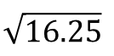
RMSE
RMSE- Root Mean Squared Error
ERROR
SQUARED
MEAN
ROOT
Actual Values | Predicted/Forecasted | Errors | Squared Errors
10 | 16 | -6 | 36
12 | 8 | 4 | 16
20 | 17 | 3 | 9
36 | 34 | 2 | 4
Mean
Square Root
36+16+9+4
$$\sqrt{16.25}$$
4
=4.03
In the same units being measured, tells you +/- the prediction error.

Slide 43

Back to script C
How good is Dale’s model?
Notes:
For the predict warning about rank deficient matrices:
Rank of the matrix is reduced since it throws out multi-collinear variables. Often can be safely ignored.

